Slide 1


COVID MANAGEMENT
KINSHUK
CHATURVEDI
1NT18CS076
PREET
CHAHAL
1NT18CS119
SAILESH PANDEY
1NT18CS201
PRANAV
SHRIVASTAVA
1NT18CS115
NITTE MEENAKSHI
INSTITUTE OF TECHNOLOGY
DEPARTMENT OF COMPUTER SCIENCE & ENGINEERING

Slide 2
ABSTRACT
When you run a healthcare facility, proper disposal of medical waste plays an important role in ensuring the safety and overall health of staff, patients and visitors. With the amount of waste produced each day, healthcare offices must be constantly prepared, or else something could go wrong during any phase of the disposal process.

Slide 3
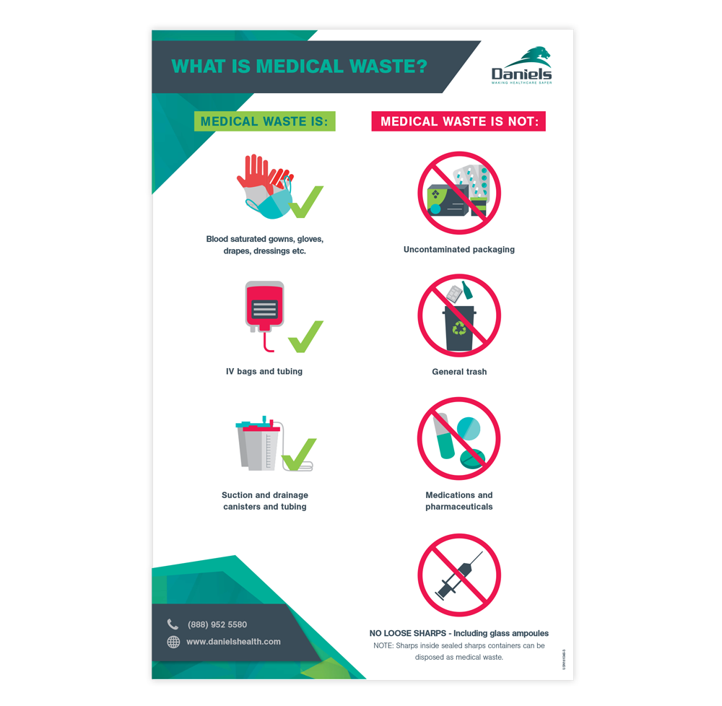

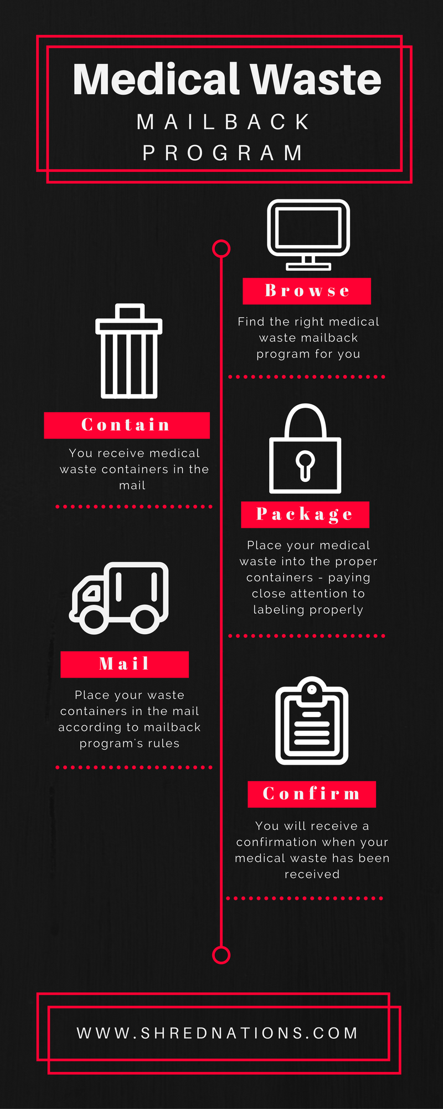

Slide 4
INTRODUCTION
As we all know, currently the whole world is fighting against COVID19. This virus has already infected 3,950,444+ people globally and 271,796+ people have lost their lives due to this deadly virus.
Government has taken certain steps to slower down the spreading rate of the virus. Covid19 has caused a great damage to the global economy .

Slide 5
INTRODUCTION
To protect ourselves from this harmful situation caused due to COVID19 i.e. CORONAVIRUS , we are advised to stay at home , wash our hands frequently with alcohol-based hand-rub or soap and practice social distancing . If you’re going outdoors, usage of masks, gloves .. etc. is mandatory.
IS THIS ENOUGH ???

Slide 6

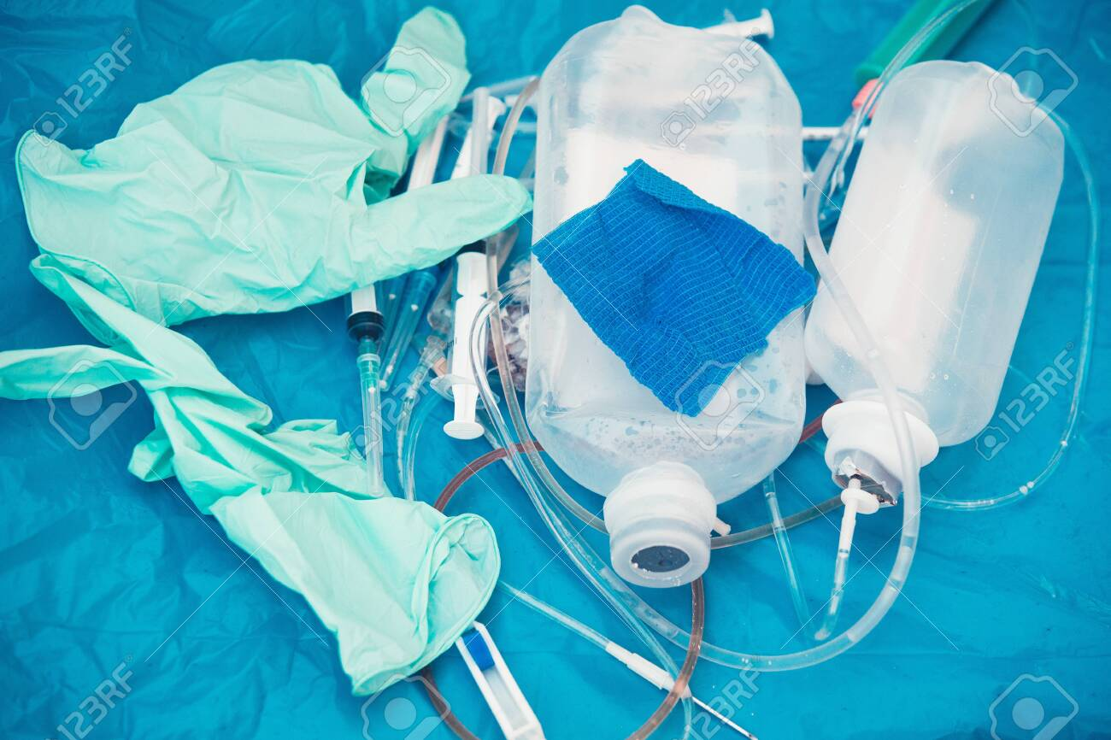

Slide 7
WHAT’S NEXT
Face masks used by the general public could be a source of infection if not discarded properly. So it is our responsibility to dispose the used masks or gloves safely. It is wrong to throw them on roads, streets or any other public places, this may only lead to spreading of the virus as it has microorganisms sitting on it. Discard the used mask immediately in a separate closed bin at home and clean hands with alcohol based soap. But keeping it at home could be dangerous too. This needs to be handled very carefully.

Slide 8
OUR PLATFORM
We have created a platform where you can schedule a pick-up of your medical waste at your doorsteps on desired date which is free of cost and we will be taking care of your medical waste i.e. where to dispose it and what to further do with it. We will also be providing you a batch of COVID HERO based on your response and activity towards us.

Slide 9
How it works
All you need to do is enter your details including your name , address , contact number , type of waste , quantity …etc. You can choose a desired date for your pickup and enter a 4 digit pin which you need to confirm at the time of pick-up . Your medical waste will be picked up by our member on desired date and address.

Slide 10
Waste
Management
Tips
COVID INDIA
Helpline No’s
Get Home
Sanitized
COVID19
MANAGEMENT
COVID INDIA
Updates
Waste
Pick-up
Self
Assessment

Slide 11
HTML
HTML stands for Hyper Text Markup Language.
It is used to design web pages using markup language.
HTML is a markup language which is used by the browser to manipulate text, images and other content to display it in required format.
Concepts Used :-
HTML Elements
HTML Styles
HTML Headings
HTML Paragraps
HTML Forms
HTML Input Attributes
HTML Images
HTML Iframes

Slide 12
CSS
Cascading Style Sheets, fondly referred to as CSS, is a simply designed language intended to simplify the process of making web pages presentable.
CSS allows you to apply styles to web pages.
More importantly, CSS enables you to do this independent of the HTML that makes up each web page.
Concepts Used :-
CSS Selectors
CSS Backgrounds
CSS Fonts
CSS Colors
CSS Box Model
CSS Forms
CSS Transitions
CSS Hovers

Slide 13
JavaScript
JavaScript is a lightweight, cross-platform and interpreted scripting language.
It is well-known for the development of web pages, many non-browser environments also use it.
JavaScript can be used for Client-side developments as well as Server-side developments.
Concepts Used :-
JavaScript Statements
JavaScript Variables
JavaScript Events
JavaScript Functions

Slide 14
PHP
The term PHP is an acronym for PHP: Hypertext Preprocessor.
PHP is a server-side scripting language designed specifically for web development.
PHP can be easily embedded in HTML files and HTML codes can also be written in a PHP file
Concepts Used :-
PHP Variables
PHP echo
PHP Data Types
PHP Conditional Statements
PHP Form Handling
PHP Sessions
PHP Include
PHP Post Method

Slide 15
MySQL
MySQL server is a open-source relational database management system which is a major support for web based applications.
Databases and related tables are the main component of many websites and applications as the data is stored and exchanged over the web.
Concepts Used :-
MySQL Database
MySQL Connect
MySQL Insert Data
MySQL Select Data

Slide 16
jQuery
jQuery is an open source JavaScript library that simplifies the interactions between an HTML/CSS document, or more precisely the Document Object Model (DOM), and JavaScript.
jQuery greatly simplifies JavaScript programming.
Elaborating the terms, jQuery simplifies HTML document traversing and manipulation, browser event handling, DOM animations, Ajax interactions, and cross-browser JavaScript development.
Concepts Used :-
jQuery Syntax
jQuery Selectors
jQuery Event
jQuery Effects - Hide and Show

Slide 17
Ajax
Ajax is an acronym for Asynchronous JavaScript and XML.
It is used to communicate with the server without refreshing the web page and thus increasing the user experience and better performance.
Concepts Used :-
AJAX - The XML Http Request Object
AJAX - Send a Request To a Server
AJAX - Server Response

Slide 18
COVID19 MANAGEMENT
USER
FRIENDLY
Free of cost
ALL FACILITIES
UNDER ONE
ROOF
Doorstep
Pick-up
SECURE

Slide 19
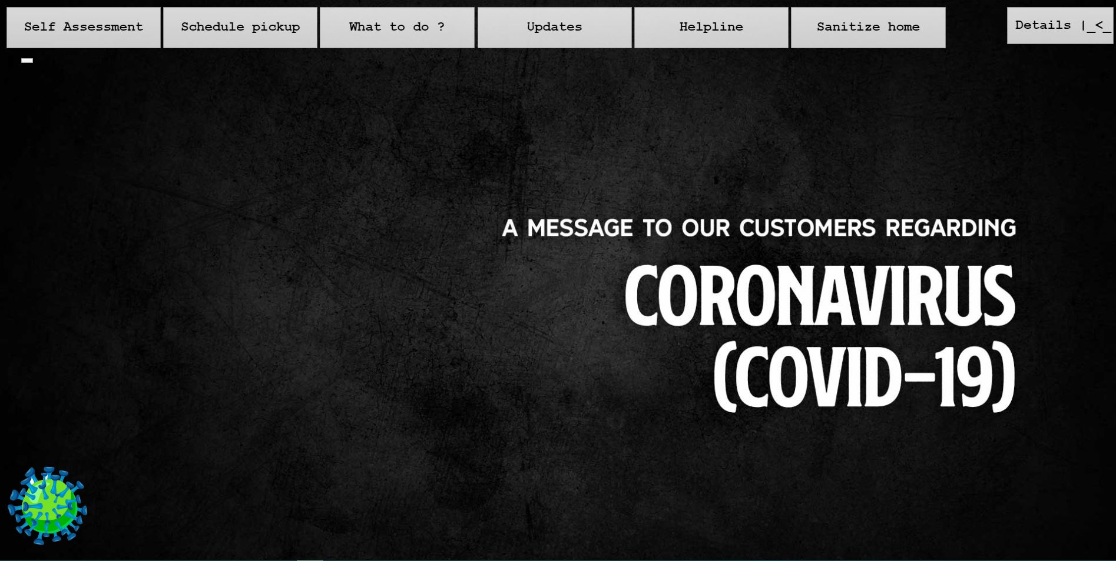

Slide 20
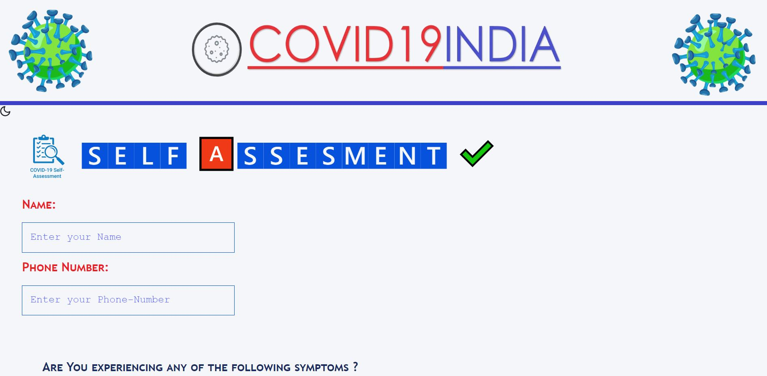

Slide 21
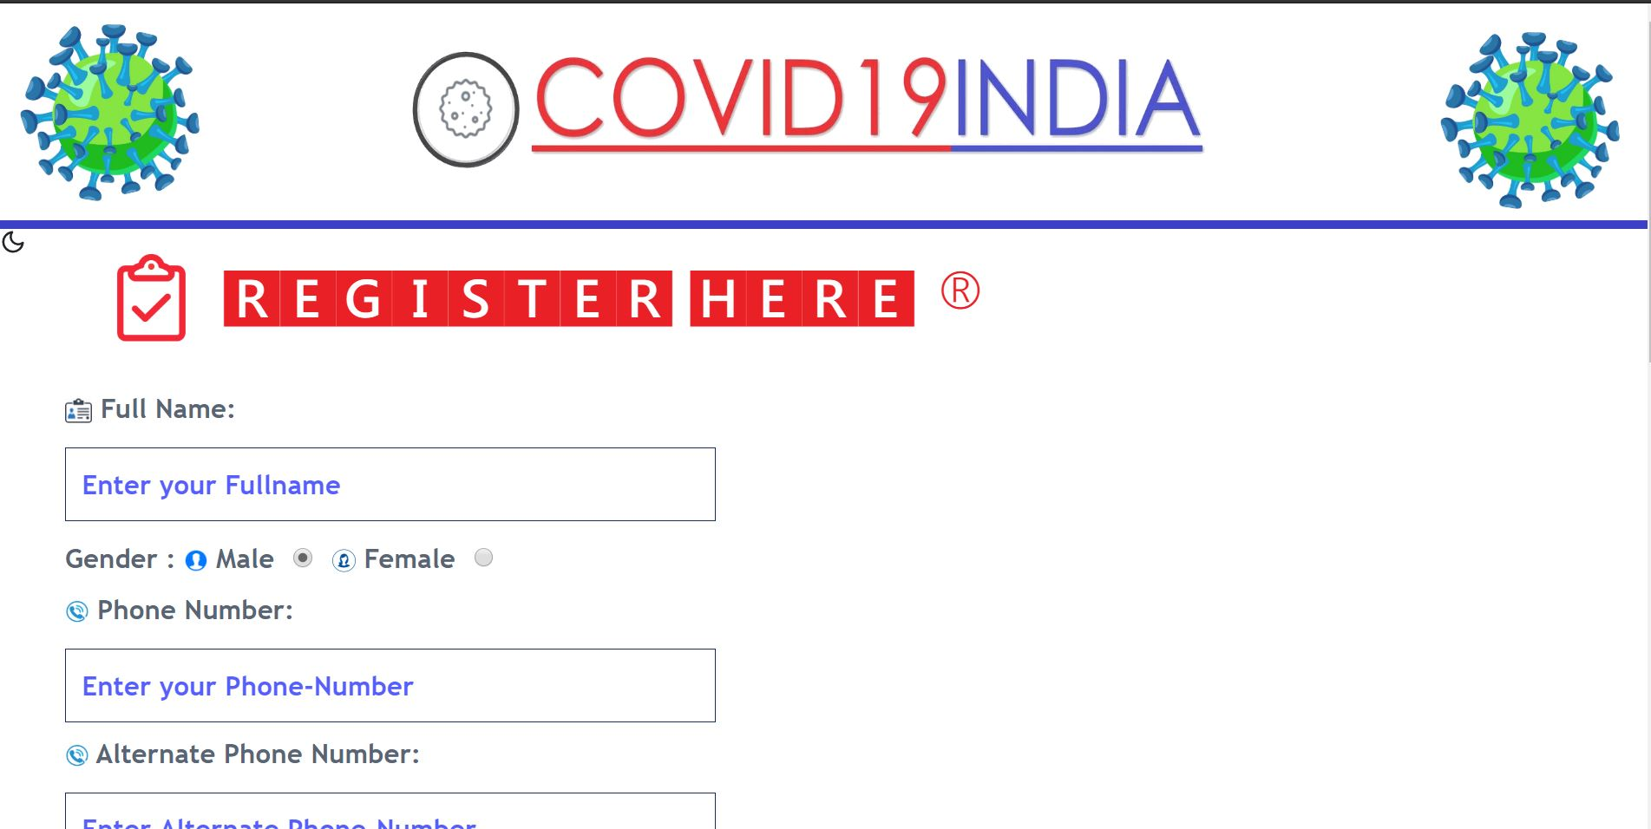

Slide 22
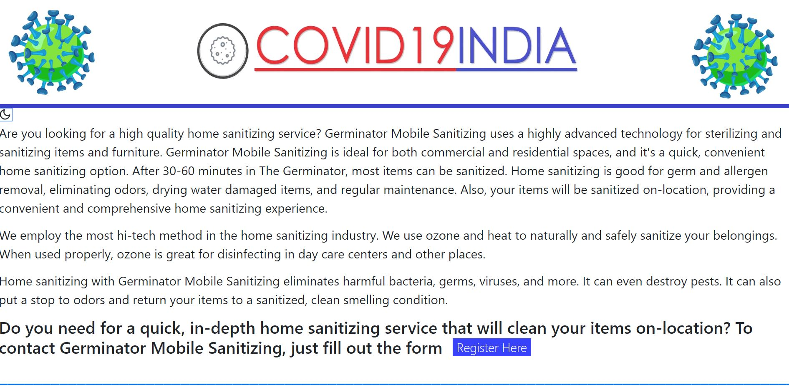

Slide 23
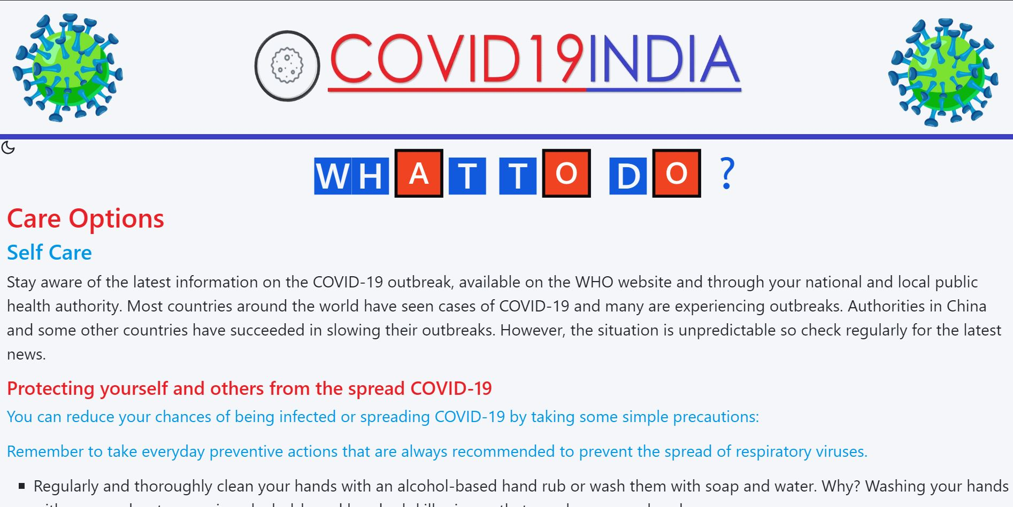

Slide 24
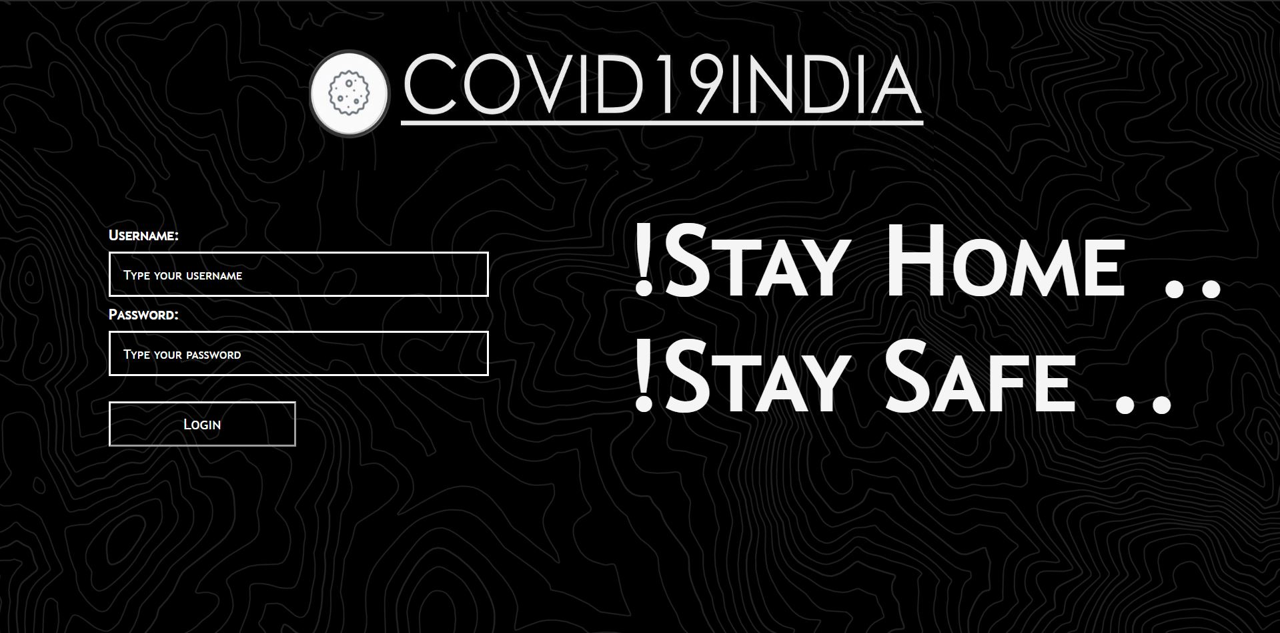

Slide 25
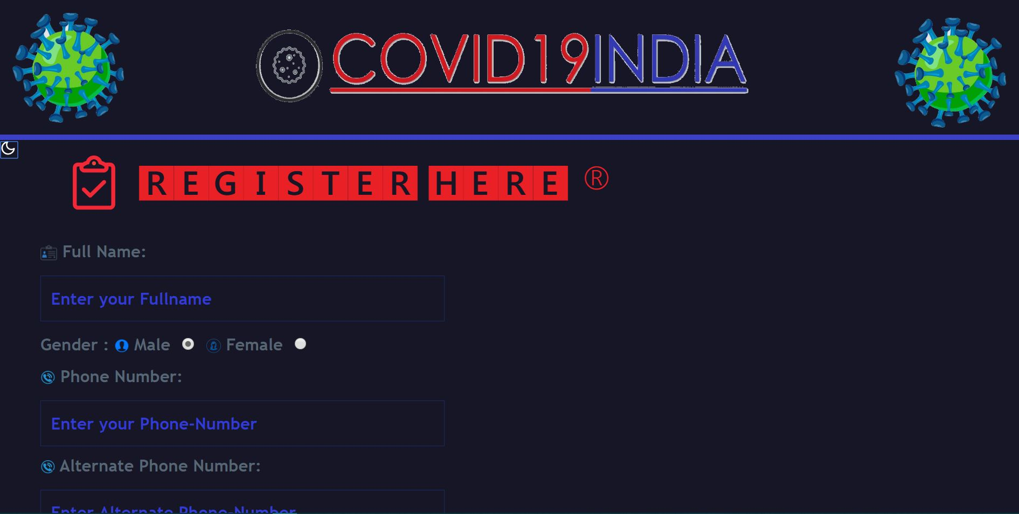

Slide 26
Conclusion
Our website is a small initiative to contribute towards a safer environment and you can help the nation to be COVID free by taking small steps towards managing your Medical waste and becoming a COVID HERO :’)) .

Slide 27
Thank
You !!

